Slide 1
CSE 111 Checkpoint I
Course Stats for UC Merced
Sahus Nulu & Kavin Rajasekaran

Slide 2
Project Overview
The goal is to simplify UC Merced students’ life by showing them relevant data that would help with scheduling classes
Students have trouble scheduling classes because they don’t which course section would be the best for them
With this, students would be able to see what Professors are rated well, what their grading scales are, what textbooks are used, and what their class timings are
Additionally, students will be able to take actions on these courses; they’ll be able to add, edit, and delete courses from their personal schedule. This personal schedule will display what classes they have currently added.

Slide 3
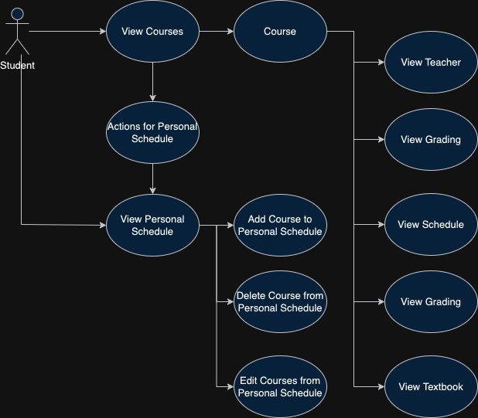
Use-Case Diagram

Slide 4
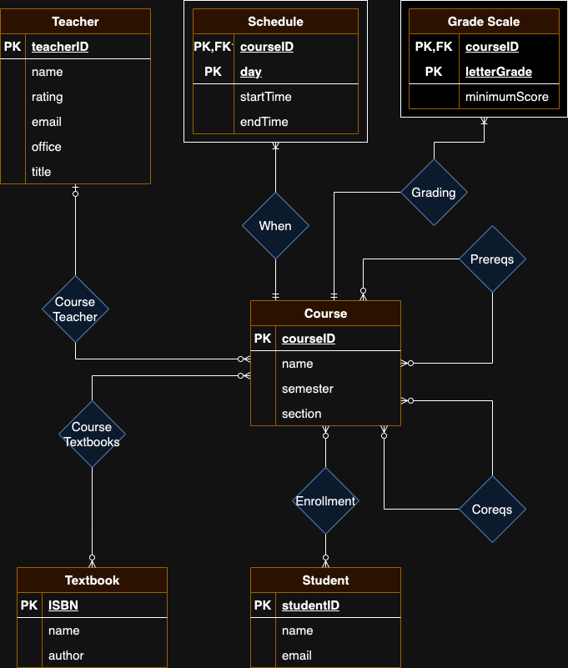
E/R Diagram

Slide 5
Relational Schema
Course
- courseID, name, semester, section
Teacher
- teacherID, name, rating, email, office, title
Schedule
- courseID, day, startTime, endTime
Grade Scale
- courseID, letterGrade, minimumScore
Textbook
- ISBN, name, author
Student
- studentID, name, email
Enrollment
- courseID, studentID,
Course Textbooks
- courseID, ISBN
Prereqs
- courseID, prereqID
Coreqs
- courseID, coreqID

Slide 6
Implementation
Database
MySQL
Simple database management system
Frontend/Backend
Budibase
Once data layer is created, makes creation of frontend and backend simpler

Slide 7
Implementation
Saltcorn

